Slide 1
Plots
Scatter Plot & Correlations
Key Ideas for Correlation
Correlation Matrix

Slide 2
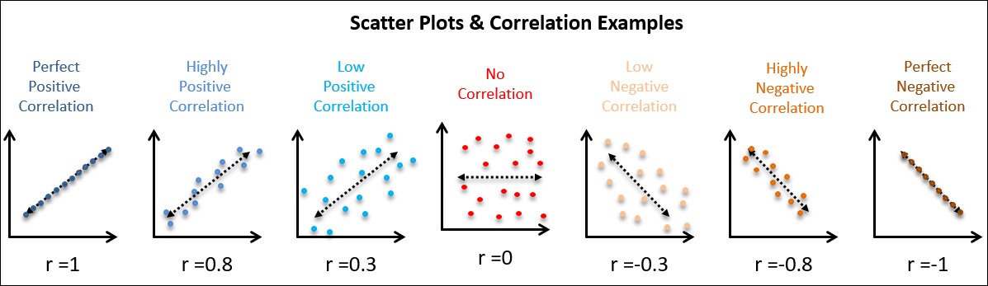
Scatterplot & Correlation
Correlation coefficient: Widely used Pearson’s correlation coefficient

Slide 3
KEY IDEAS FOR CORRELATION
The correlation coefficient measures the extent to which two variables are associated with one another.
When high values of v1 go with high values of v2, v1 and v2 are positively associated. When high values of v1 are associated with low values of v2, v1 and v2 are negatively associated.
The correlation coefficient is a standardized metric so that it always ranges from –1 (perfect negative correlation) to +1 (perfect positive correlation).
A correlation coefficient of 0 indicates no correlation, but be aware that random arrangements of data will produce both positive and negative values for the correlation coefficient just by chance.

Slide 4
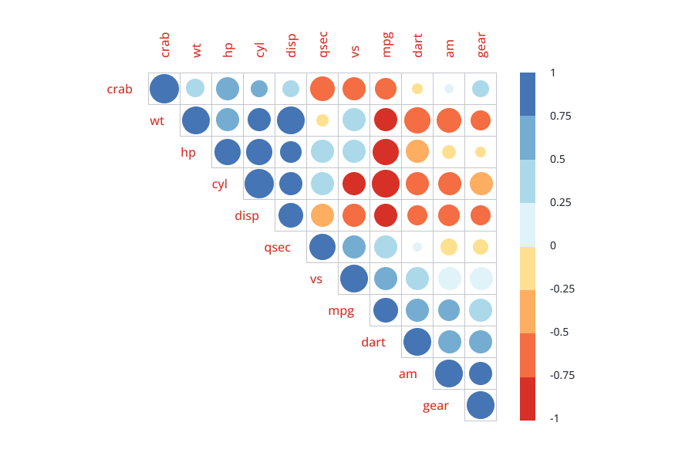
CORRELATION MATRIX
A correlation matrix is a table that displays correlation coefficients between pairs of variables
Like the mean and standard deviation, the correlation coefficient is sensitive to outliers in the data

